Slide 1
Programming Fundamentals
Lecture 23 – 24

Slide 2
Objectives
Types of Inheritance
Diamond Problem
Virtual Inheritance
Pointer to Objects

Slide 3
Types of Inheritance (1/2)
There are five major types of inheritance
  Single Inheritance
  Multilevel Inheritance
  Hierarchical Inheritance
  Multiple Inheritance
  Hybrid Inheritance
    Multipath Inheritance
In each type of inheritance we can use private, public or protected mode

Slide 4
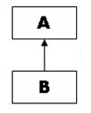
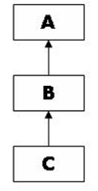
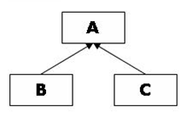
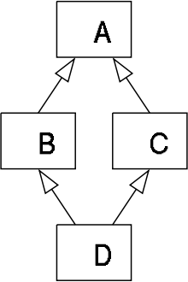
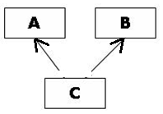
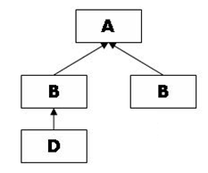
Types of Inheritance (2/2)
Single Inheritance
Hierarchical Inheritance
Multilevel Inheritance
Multiple Inheritance
Hybrid Inheritance
Multipath Inheritance

Slide 5
Single Inheritance
If there is one base class and one derived class, then this form of inheritance is called single inheritance
If you create an object of derived class, then the default constructors of base and derived class are called
The order of constructor call is
  Base class constructor is called first
  Then the derived class constructor is called

Slide 6
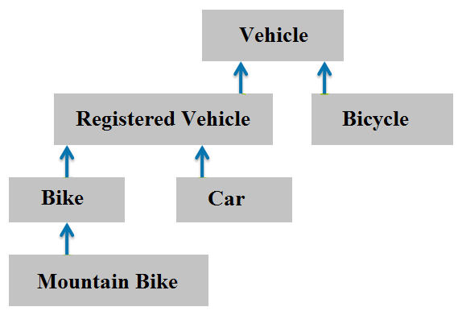
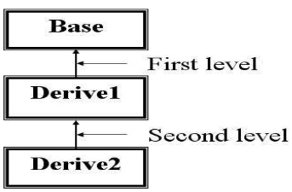
Multilevel Inheritance
In C++ programming, not only you can derive a class from the base class but you can also derive a class from the derived class. This form of inheritance is known as multilevel inheritance

Slide 7
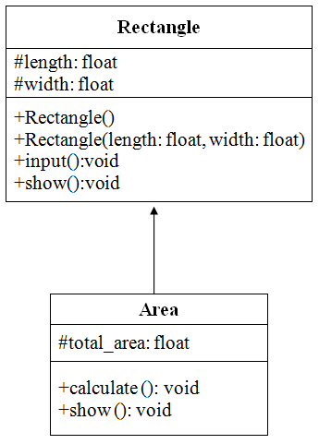
Multilevel Inheritance – Example
We have two classes as shown by UML class diagram
Now we want to compute the paint cost at a rate of 30$ per m². Create a new class to compute and display the paint cost
See the attached file “multilevel_inheritance” for solution

Slide 8
Multilevel Inheritance – Example (Analysis)
The results of our program are incorrect
This is due to ambiguity raised by function overriding
We have the function named show() in all three classes, similarly the function named calculate() is present in both derived classes
In order to get the correct result we need to use scope resolution operator while calling the functions in main()

Slide 9
Multilevel Inheritance – Example (Another way to Solve)
Instead of mentioning the class name again and again in main and calling the functions of different classes we can do it in a more efficient way
We will call the calculate function of Area class in Calculate function of Paint_cost class
Similarly we will call the show() functions of Rectangle and Area class in the show() function of Paint_cost class
This will make the main program more simple and smaller

Slide 10
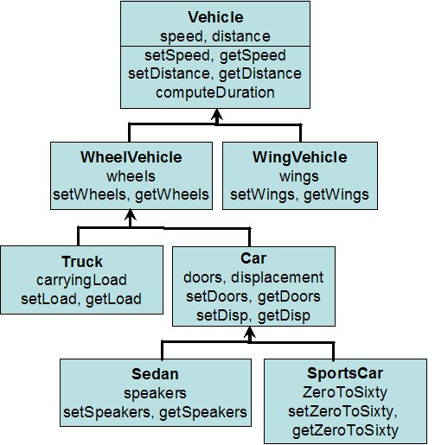
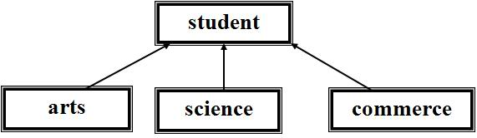
Hierarchical Inheritance (1/2)
If more than one classes are inherited from the base class, it's known as hierarchical inheritance
In hierarchical inheritance, all features that are common in child classes are included in the base class
Problems where hierarchy has to be maintained can be solved easily using this inheritance

Slide 11
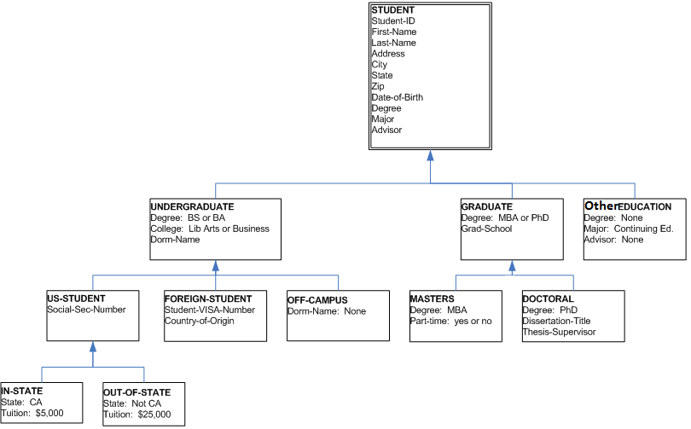
Hierarchical Inheritance (2/2)

Slide 12
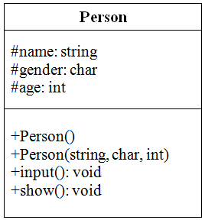
Hierarchical Inheritance – Example
We have a class as shown by UML diagram
Create two more classes named student and employee
The student has the additional attributes of institute and degree level along with name, age and gender
Similarly the employee has the additional attributes of company name and hours along with name, age and gender. The salary of employee also needs to be calculated at a rate of Rs.1100/- per hour
Write a main program to get and display the data for a student and an employee
See the attached file “Hierarchical Inheritance” for solution

Slide 13
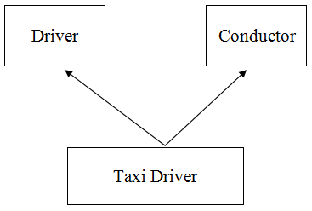
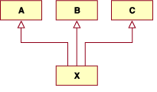
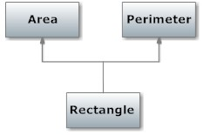
Multiple Inheritance (1/2)
Multiple Inheritance is a feature of C++ where a class can inherit from more than one classes.
JAVA does not support multiple inheritance

Slide 14
Multiple Inheritance (2/2)
The syntax for multiple inheritance is
class derived: public base1, public base2
The order of base classes can change
The constructors of inherited classes are called in the same order in which they are inherited
Have a look at the example code “Multiple_inheritance_Constructor_Call”

Slide 15
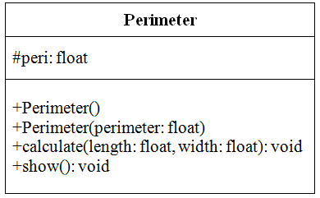
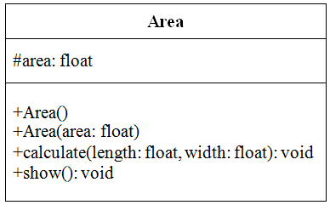
Multiple Inheritance – Example
Suppose that we have two classes as shown by UML diagram.
Write a code to compute the area and perimeter of a rectangle
See the attached file “Multiple_Inheritance” for solution

Slide 16
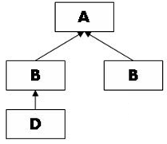
Hybrid and Multipath Inheritance
Hybrid Inheritance
  If more than one form of inheritance combine is a single program, then this form of inheritance is called hybrid inheritance
Multipath Inheritance
  One special type of hybrid inheritance is multipath inheritance
  In multipath inheritance Hierarchical and Multiple inheritance are combined
    Two classes are derived from a single base class (Hierarchical inheritance)
    Then another class is derived by considering both the derived classes as base (multiple inheritance)

Slide 17
Diamond Problem
The diamond problem occurs when two base classes of a class have a common base class
The problem arises due to fact that when we derive class D, it will get two copies of class A and compiler will get confused that which one it must use
Have a look at the file “diamond problem”

Slide 18
Solution to Diamond Problem
The solution to diamond problem is virtual inheritance
When we use virtual inheritance, we are guaranteed to get only a single instance of the common base class
We can declare the inheritance as virtual by declaring the keyword “virtual” before the access specifier while inheriting the class
  class B: virtual public A
  class C: virtual public A

Slide 19
Pointers to Objects
Just like pointers to other data types (int, float, char etc) we can declare pointers to objects
The syntax for pointer to an object is
class_name *pointer_name;
For example, we have defined a class named Date and we want to declare a pointer to the object of Date class
Date *dptr;

Slide 20
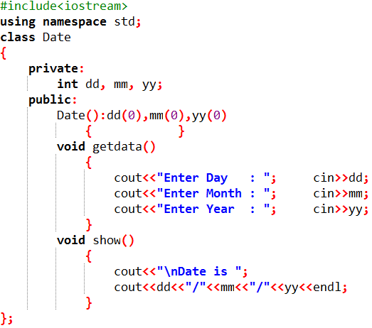
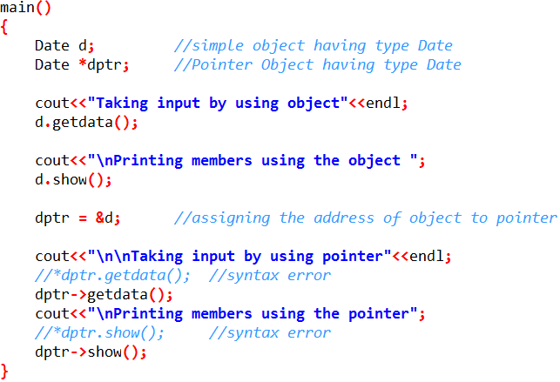
Pointers to Objects (Example)
Lets define a class named Date to input and display the date by using pointers
File with the name “Pointer_to_Object” is available on slate

